Slide 1
HTML5 Basics
Ci-Wei Lan 藍啟維
Dept. of CSE, NTOU

Slide 2
Outline
Understand foundational components of HTML5 documents
  Create and use hyperlinks to help users navigate web pages.
  Mark up lists of information.
  Create tables with rows and columns of data.
Use HTML5 to create semantic web pages
Code Examples Download
  `git clone https://github.com/lancwyy/WebDev.git`

Slide 3

Hypertext Markup Language (HTML)
Original needs of HTML
  Hypertext: Allows the creation of cross-document links within files.
  Markup Language: Uses tags to describe the structure and content of a document.
  Cross-platform display: Any computer with a browser can display HTML documents.
HTML is a declarative language
Markup language is a text-encoding system
  “A set of rules governing what markup information may be included in a document and how it is combined with the content of the document in a way to facilitate use by humans and computer programs.” — Wikipedia, "Markup language", https://en.wikipedia.org/wiki/Markup_language
  <h1>NTOU</h1> vs <b>NTOU</b>
*Check it out! https://www.semrush.com/blog/markup-language/

Slide 4
HTML General Rules
Markup is enabled by defined tags
  Tags usually come in pairs
  Nesting is valid
Case in-sensitive
  Strongly recommended lowercase
Reserved characters
  Instead of direct typing in standard keyboard, special characters are used.
  &lt; in HTML file is displayed as < in browsers.
Whitespace collapse
  Browsers ignore extra spaces and line breaks in your source code.
  Using special characters or CSS for spacing.
HTML is highly forgiving
  By modern powerful browser rendering engine, invalid HTML could be displayed with the best effort rather than crashing.
  Keep HTML contents valid as much as possible for deterministic presentation.
  Validate your HTML by W3 Nu HTML Checker: https://validator.w3.org/nu

Slide 5
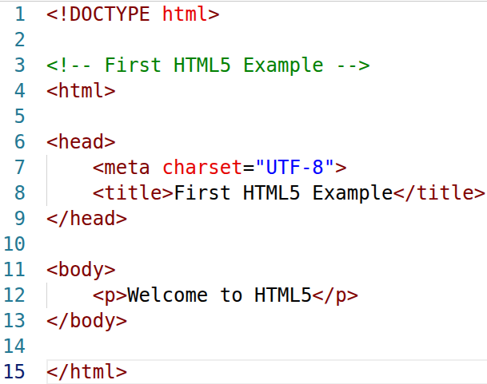
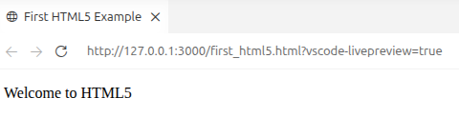
HTML5 Code Example

Slide 6
Document Type Declaration (DTD)
The document type declaration (DOCTYPE) is required in HTML5 documents so that browsers render the page in standards mode.
  <!DOCTYPE html>
Some browsers operate in quirks mode to maintain backward compatibility with web pages that are not up-to-date with the latest standards.
Historically HTML 4.01 required a specific DTD for validation (derived from SGML).
  <!DOCTYPE HTML PUBLIC "-//W3C//DTD HTML 4.01//EN" "http://www.w3.org/TR/html4/strict.dtd">
    Ref: https://developer.mozilla.org/en-US/docs/Web/HTML/Guides/Quirks_mode_and_standards_mode
    Ref: https://www.freecodecamp.org/news/what-is-the-doctype-declaration-in-html/
Though HTML is case-insensitive, strongly recommended uppercase for DTD declaration.

Slide 7
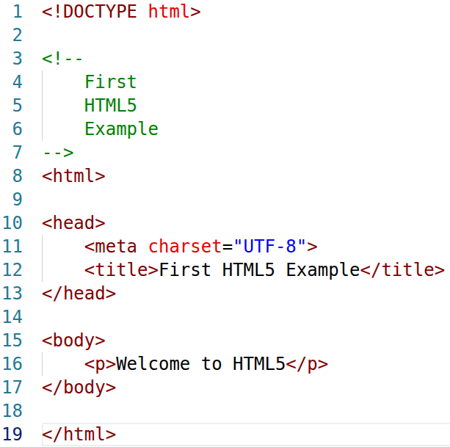
Comments in HTML
Insert comments in your HTML5 markup to improve readability and describe the content of a document.
The browser ignores comments when your document is rendered.
Comments start with <!-- and end with -->.

Slide 8
HTML Required Elements
<html>
  The root element in an HTML file, enclosing the head section and the body section.
<head>
  A container holding metadata of the HTML file.
  Contents are not displayed to the end user.
  Contents specify document's title, character set, linked stylesheets, scripts etc. Each is specified with defined tags, e.g. <title></title>, <meta>, <link>,<script></script> etc.
<body>
  All the visible elements of a webpage.

Slide 9
Document Metadata ─ <meta>
A valid way of adding metadata to a HTML document, supporting browsers, search engines, and other web services to understand the content and purpose of the web page.
<meta> is a void element
  Cannot have any child nodes (i.e., nested elements or text nodes).
  It’s self-closing, no closing tag is required.
<meta> is a nested element given charset attribute is presented
  <meta charset=”UTF-8”> is always enclosed by <head></head>
  UTF-8 (8-bit Unicode Transformation Format) is the dominant character encoding standard for the internet, used by nearly all websites.

Slide 10
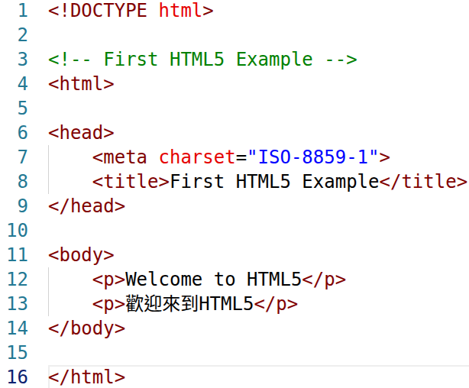
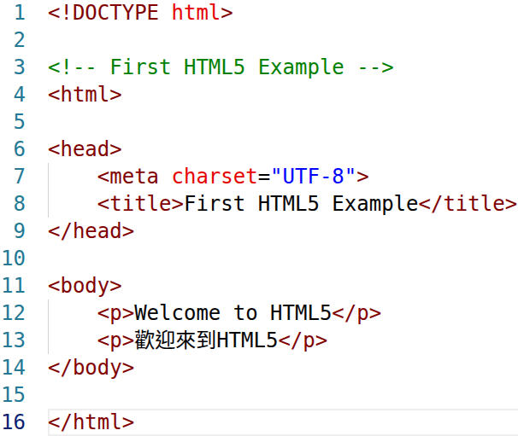


Document Metadata ─ <meta> Example

Slide 11
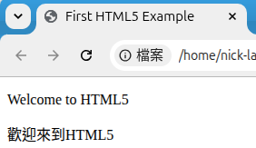
Document Metadata ─ <title>
<title> is a nested element, always enclosed by <head></head>.
Defines the document's title that is shown in a browser's title bar or a page's tab and also as the text identifying a page when users add the page to their list of Favorites or Bookmarks.
Search engines use the title for indexing purposes and when displaying results.
It only contains text; HTML tags within the element, if any, are also treated as plain text.

Slide 12
Try it Yourself ─ Metadata Practices
<html> attribute
  Learn what ‘lang’ attribute is and what’s difference between ‘lang’ and ‘charset’
Texts in <title>
  Put an <h1> along with texts within <title></title>
Add a custom favorite icon
  Learn external resource link element by <link rel="icon" href="favicon.ico" type="image/x-icon" />
  https://developer.mozilla.org/en-US/docs/Learn_web_development/Core/Structuring_content/Webpage_metadata

Slide 13
Markup Tags within <body> ─ Texts

Slide 14
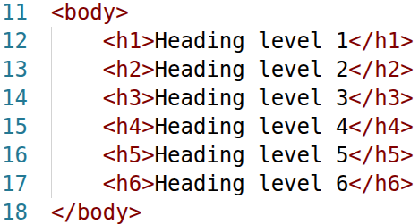
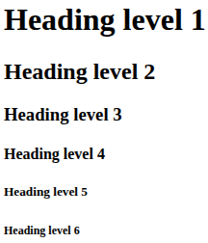
Heading Elements
HTML5 provides six heading elements (h1 through h6) for specifying the relative importance of information
  Heading element h1 is considered the most significant heading and is rendered in the largest font.
  Each successive heading element (i.e., h2, h3, etc.) is rendered in a progressively smaller font.
By default, all heading elements create a block-level box in the layout, starting on a new line and taking up the full width available in their containing block.

Slide 15
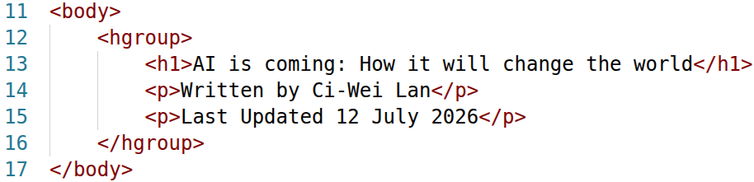
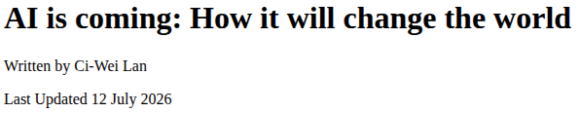
Heading Group Element ─ <hgroup>
<hgroup> contains exactly one heading element (<h1> through <h6>) grouped with one or more <p> elements.
<hgroup> is used exclusively to pair a single title with its subheadings, taglines, or alternative text.

Slide 16
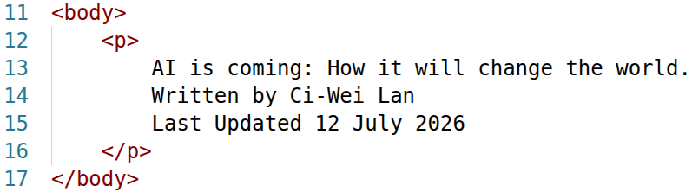
Paragraph Element ─ <p>
All text placed between the <p> and </p> tags forms one paragraph.
Browsers automatically add a single blank line before and after each paragraph, creating a clear separation between blocks of text, i.e. a block-level element.

Slide 17
HTML Reserved Characters
Character | Entity Name | Entity Number
< | &lt; | &#60;
> | &gt; | &#62;
& | &amp; | &#38;
" | &quot; | &#34;
' | &apos; | &#39;
Space (non-breaking) | &nbsp; | &#160;
© | &copy; | &#169;
® | &reg; | &#174;
™ | &trade; | &#8482;
€ | &euro; | &#8364;
£ | &pound; | &#163;
¥ | &yen; | &#165;
→ | &rarr; | &#8594;
← | &larr; | &#8592;
↑ | &uarr; | &#8593;
↓ | &darr; | &#8595;

Slide 18
Thematic Element ─ <hr>
A thematic break between paragraph-level elements, serving as semantic terms now, hr stands for horizontal rule.
A void element.
Using CSS for presentational style is recommended.

Slide 19
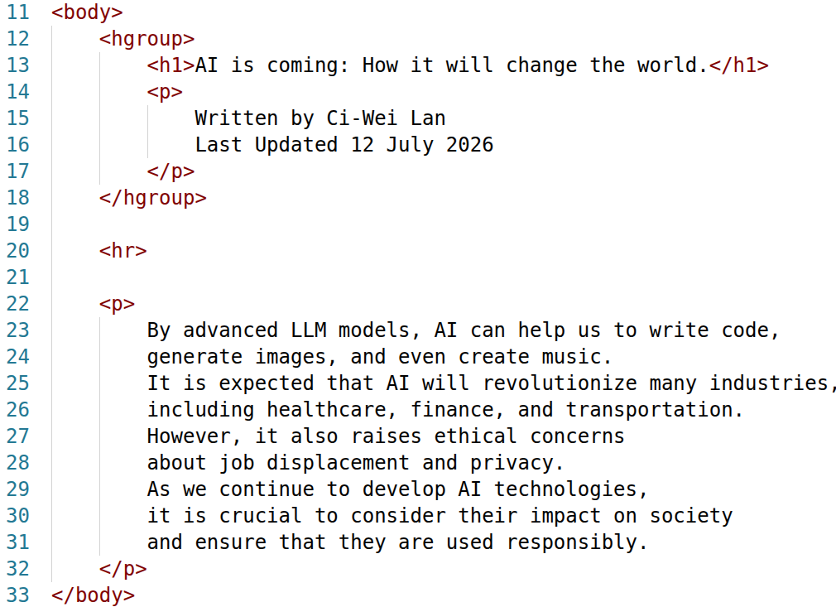
An Example of <hr>

Slide 20
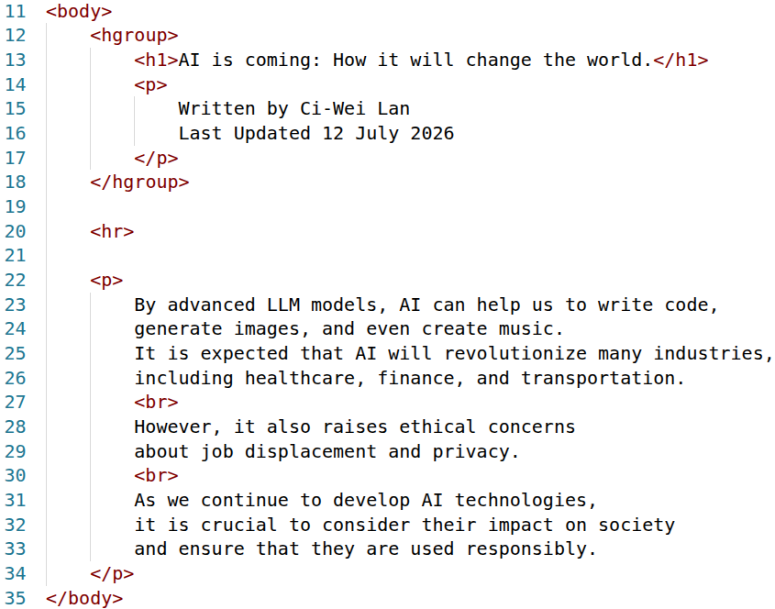
Line breaker ─ <br>
Creates a line break within a text block. It's used to start a new line without creating a new paragraph.

Slide 21
Grouping Elements ─ <div> and <span>
<div>
  A generic block-level container for flow content, i.e. all valid elements within <body>.
    Can be a child element of flow content except for <p> and <button>
<span>
  A generic inline container for phrasing content, i.e. all textual elements including audio and video.
    Can be a child element of phrasing content
Both elements have no effect on the content or layout until styled in some way using CSS.
  No semantic implication but commonly used to be a placeholder for dynamic content or styling.

Slide 22
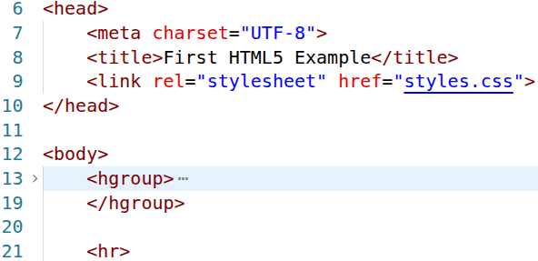
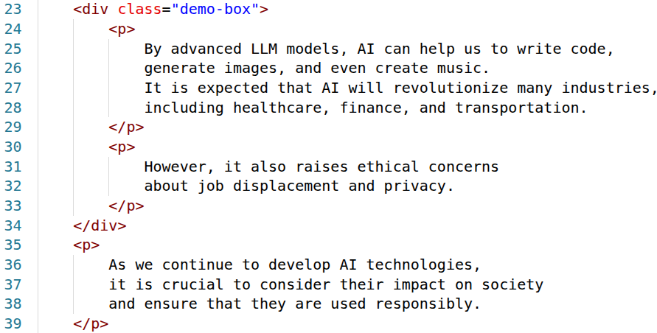
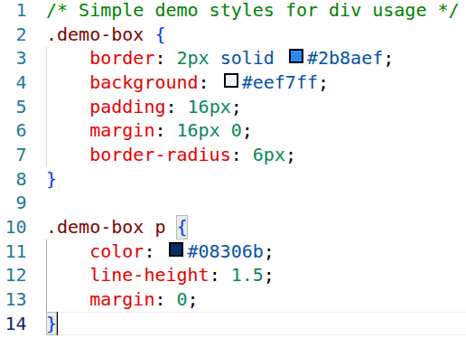
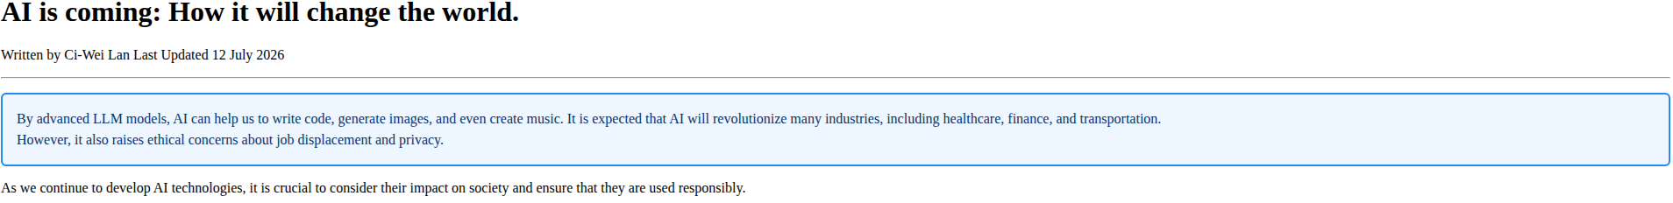
An Example of <div>

Slide 23
Global Attributes
Global attributes are attributes common to all HTML elements; they can be used on all elements, though they may have no effect on some elements.
Control things like element styling, identification, accessibility, and event handling, allowing you to modify how elements behave and interact within a webpage.
Offer a consistent way to manage common element characteristics across different browsers and devices.

Slide 24
Global Attributes ─ id
The id attribute defines an identifier (ID) that must be unique within the entire document.
Technically, the value for an ID attribute may contain any other Unicode character except for ASCII whitespace characters (space, tab or carriage return).
Naming best practice: lower alphabets connected by ‘-’ (avoid using CSS or JavaScript reserved words as ID values.)
id value is case-sensitive.

Slide 25
Global Attributes ─ class
The class attribute defines a space-separated list of the classes of the element, i.e. an element can have multiple classes.
Allow CSS and JavaScript to select and access specific elements via the class selectors or functions like the method Document.getElementsByClassName().
Naming best practice: lower alphabets connected by ‘-’ (avoid using CSS or JavaScript reserved words as ID values.)
class value is case-sensitive.

Slide 26
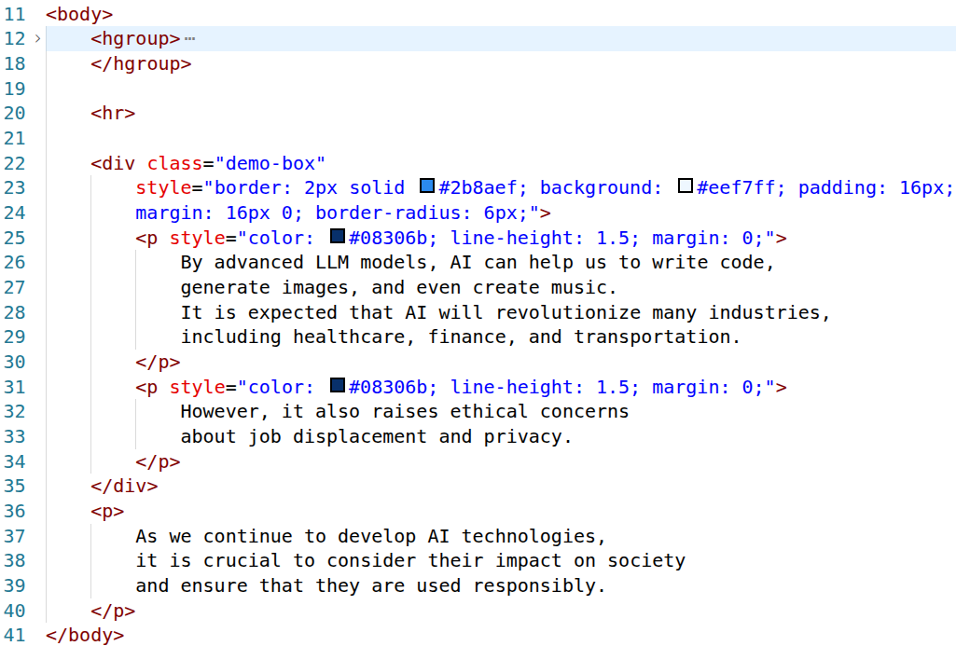
Global Attributes ─ style
The style attribute contains CSS styling declarations applying to the element.
Inline styles, overriding external stylesheets or default browser styles.
Effects on the individual element only.

Slide 27
Global Attributes ─ data-*
The data-* attribute forms a class of attributes, called custom data attributes, that allow proprietary information to be exchanged between the HTML and its DOM representation.
All such custom data are available via the HTMLElement interface of the element the attribute is set on. The HTMLElement.dataset property gives access to them.
The * may be replaced by any name following the production rule of XML names which includes the following recommendations:
  The name should not start with xml (case-insensitive), as it's reserved for future XML specifications.
  The name should not contain any colon characters (:), as XML assigns meaning to such names.
  The name should not contain any capital letters, as XML is all lowercase.
Check it out: https://developer.mozilla.org/en-US/docs/Web/HTML/Reference/Global_attributes/data-*

Slide 28
Hyperlink Element ─ <a>
The <a> anchor element creates a hyperlink to web pages, files, email addresses, locations in the same page, or anything else a URL can address.
Writing descriptive and accessible link text
  Web browsers typically underline text hyperlinks and color them blue by default.
href (Hypertext reference) is one of key attributes specifying the URL that the hyperlink points to.
  Sections of a page with document fragments
  Specific text portions with text fragments
  Any external file identified by a URL
Links are not restricted to HTTP-based URLs — they can use any URL scheme supported by browsers:
  Telephone numbers with tel: URL
  Email addresses with mailto: URL
  SMS text messages with sms: URL

Slide 29
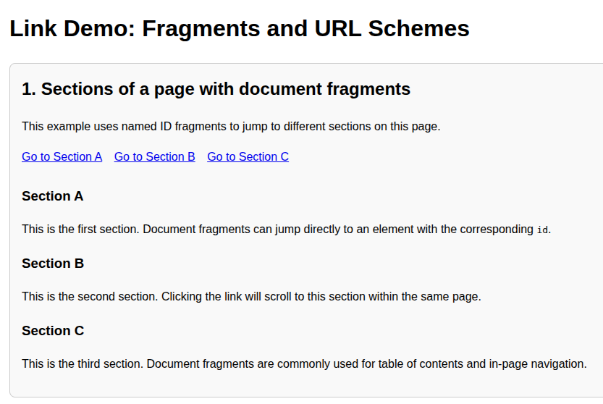
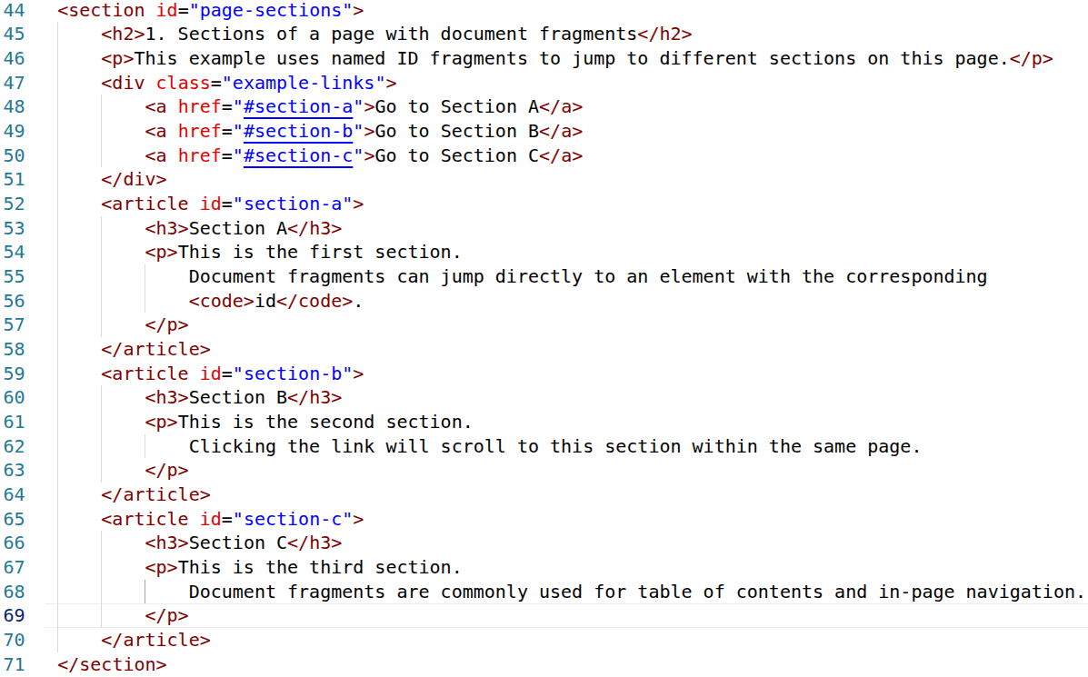
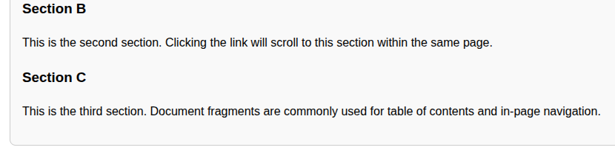
Examples of <a> ─ Page Section

Slide 30
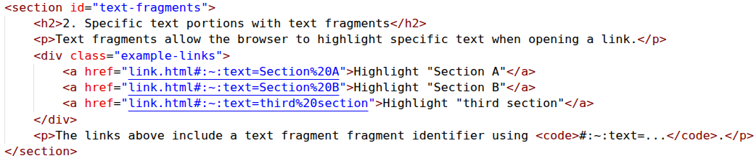

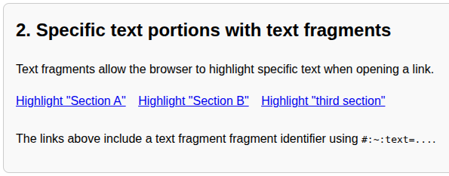
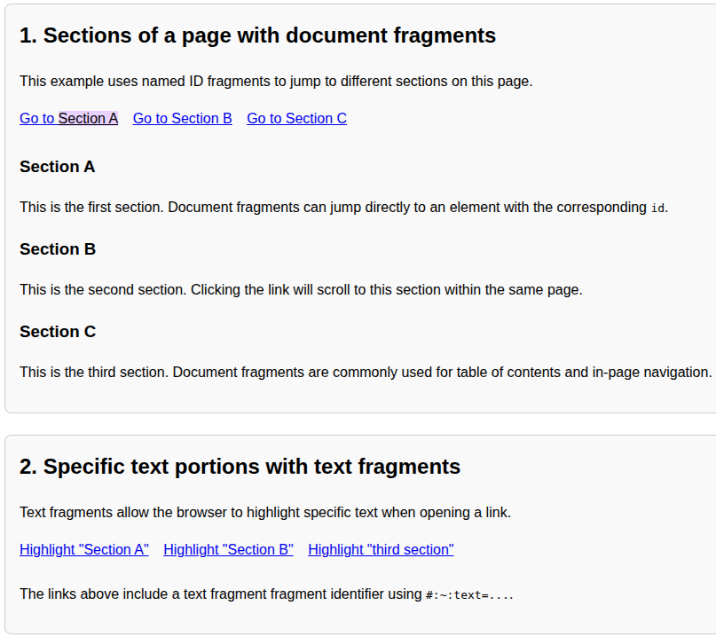
Examples of <a> ─ Text Fragments

Slide 31
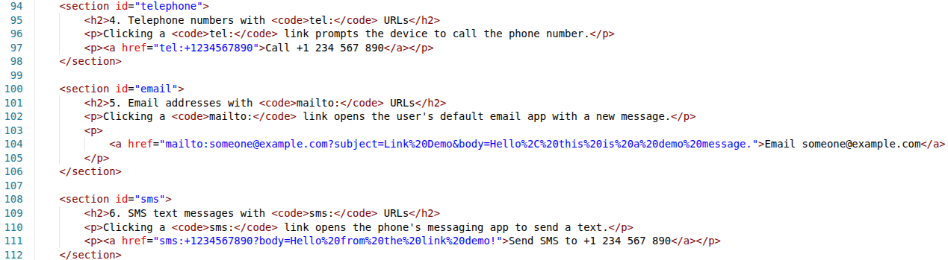
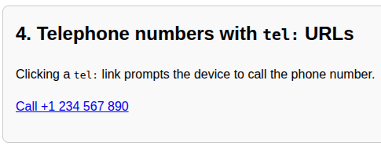
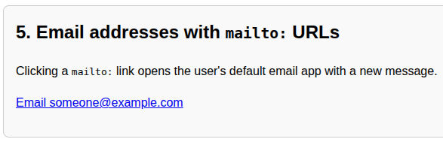
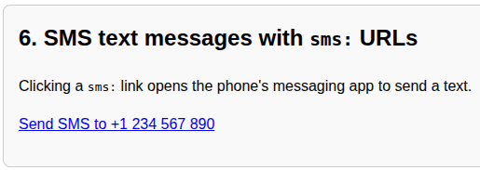
Examples of <a> ─ Telephone, Email and SMS

Slide 32
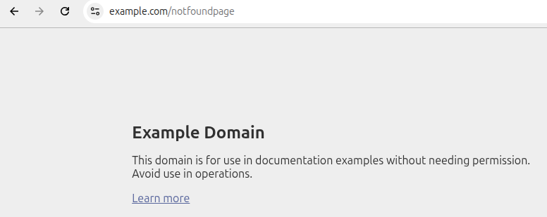
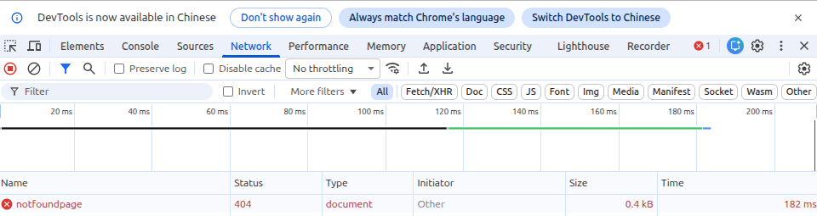
What if a Resource is missing?
The host is reachable but the resource is missing

Slide 33
HTTP Status Code
Leading Digit | Range | Meaning | Example Codes | Explanation
1xx Informational | 100–199 | Request received, continue process | 100 Continue | Client should continue sending request body
2xx Success | 200–299 | Request successfully completed | 200 OK 201 Created 204 No Content | Resource retrieved, created, or no content returned
3xx Redirection | 300–399 | Further action needed (redirect) | 301 Moved Permanently 302 Found 304 Not Modified | Resource moved or cached
4xx Client Error | 400–499 | Problem with client request | 400 Bad Request 401 Unauthorized 403 Forbidden 404 Not Found 429 Too Many Requests | Invalid request, missing auth, forbidden, not found, rate limit exceeded
5xx Server Error | 500–599 | Server failed to fulfill request | 500 Internal Server Error 502 Bad Gateway 503 Service Unavailable 504 Gateway Timeout | Server crash, upstream error, service down, timeout

Slide 34
URL Common Reserved Characters
Character | Encoding | Usage
[:] Colon | %3A | Protocol separator (e.g., http:)
[/] Slash | %2F | Path separator
[?] Question mark | %3F | Start of query string
[#] Hash | %23 | Fragment (anchor) start
[&] Ampersand | %26 | Query parameter separator
[=] Equal sign | %3D | Key/Value separator
[@] At sign | %40 | User info separator
[+] Plus sign | %2B | Represents space in application/x-www-form-urlencoded
[%] Percent sign | %25 | Escape indicator for encoding

Slide 35
Common Pitfalls in URL Encoding
Ampersand & in query strings
  Structural use: ?a=1&b=2 → no encoding needed
  Data use: ?q=Tom%26Jerry → must encode %26
Slash / in paths
  Structural use: /products/apparel → no encoding needed
  Data use: /A%2FB_Testing → %2F encodes slash as data
Question mark ?
  Structural use: /search?q=test → marks query start, no encoding needed
  Data use: ?q=What%3F → %3F encodes question mark as data

Slide 36
Hyperlink Element ─ target attribute of <a>
Where to display the linked URL, as the name for a browsing context
_self: The current browsing context. (Default)
_blank: Usually a new tab, but users can configure browsers to open a new window instead.
  Setting target="_blank" on <a> elements implicitly provides the same rel behavior as setting rel="noopener" which does not set window.opener.
_parent: The parent browsing context of the current one. If no parent, behaves as _self.
_top: The topmost browsing context. To be specific, this means the "highest" context that's an ancestor of the current one. If no ancestors, behaves as _self.
_unfencedTop: Allows embedded fenced frames to navigate the top-level frame (i.e., traversing beyond the root of the fenced frame, unlike other reserved destinations). Note that the navigation will still succeed if this is used outside of a fenced frame context, but it will not act like a reserved keyword.

Slide 37
Try it Yourself ─ Textual Tag Practices
Learn each of following tags
  <b> and <strong> and what’s difference
  <pre>
  <i> and <em> and what’s difference
  <mark>
  <sub>
  <sup>

Slide 38
Markup Tags within <body> ─ Lists

Slide 39
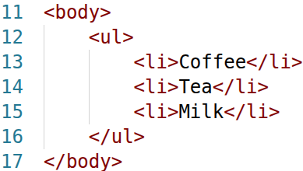

Unordered List ─ <ul>
The <ul> element is for grouping a collection of items that do not have a numerical ordering, and their order in the list is meaningless.
Typically, unordered-list items are displayed with a bullet, which can be of several forms, like a dot, a circle, or a square.
The bullet style is not defined in the HTML description of the page, but in its associated CSS, using the list-style-type property.
Each entry is an li (list item) element. Most web browsers render these elements with a line break and a bullet symbol at the beginning of the line.

Slide 40
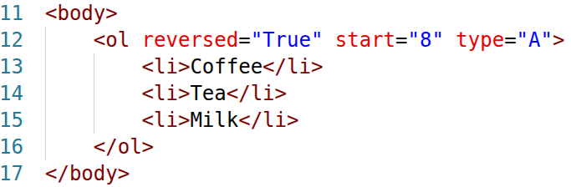

Ordered List ─ <ol>
Typically, ordered list items display with a preceding marker, such as a number or letter.
Attributes
  reversed: This Boolean attribute specifies that the list's items are in reverse order. Items will be numbered from high to low.
  start: An integer to start counting from for the list items. Always an Arabic numeral (1, 2, 3, etc.)
  type:
    a for lowercase letters
    A for uppercase letters
    i for lowercase Roman numerals
    I for uppercase Roman numerals
    1 for numbers (default)

Slide 41
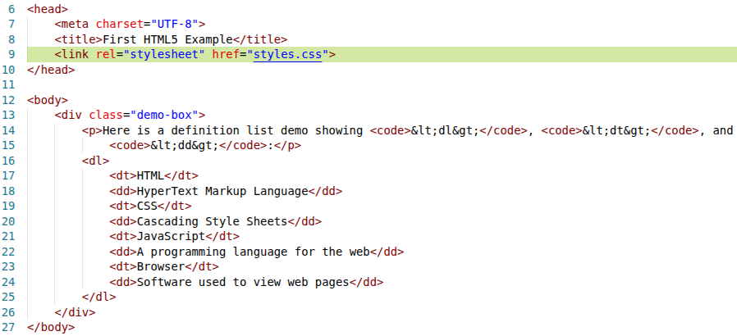
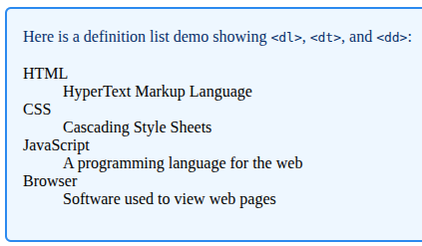
Definition List ─ <dl>
The <dl> HTML element represents a definition list. It encloses a list of definition terms (specified using the <dt> element) and descriptions (provided by <dd> elements).

Slide 42
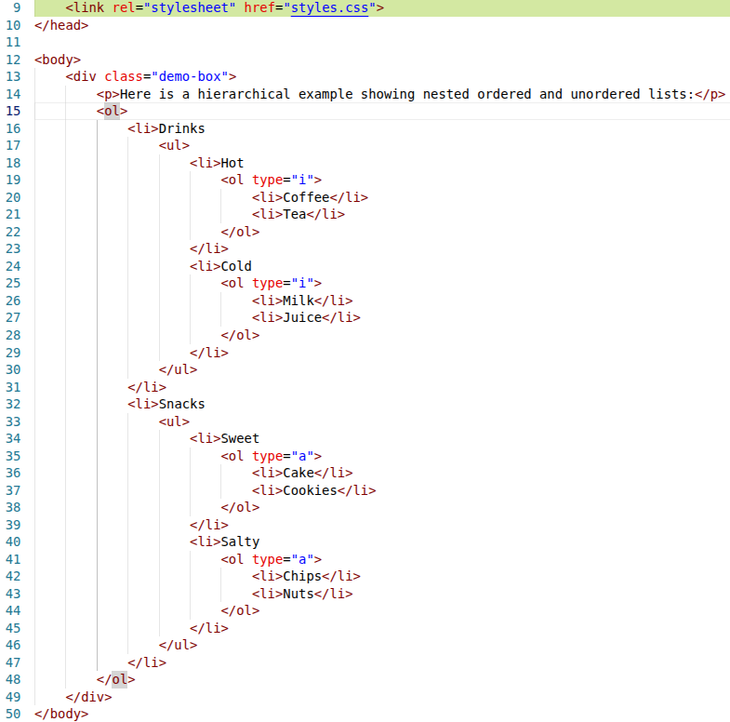
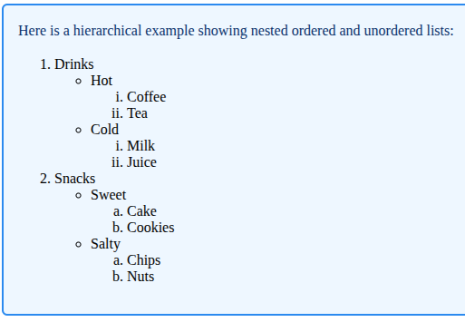
Hierarchical Structure ─ Nested Lists

Slide 43
Markup Tags within <body> ─ Table

Slide 44
Tabular Elements ─ <table>
The <table> element represents tabular data—that is, information presented in a two-dimensional table comprised of rows and columns of cells containing data.
  Attributes are deprecated and suggest using CSS for styling instead.
Table title (<caption> element): Describe the purpose of the table
  If included, <caption> must be the first child node of <table>
A table can be split into three distinct containers:
  Head (<thead> element): Column headers etc.
  Body (<tbody> element): Primary table data
  Foot (<tfoot> element): Calculation results, footnotes etc.

Slide 45
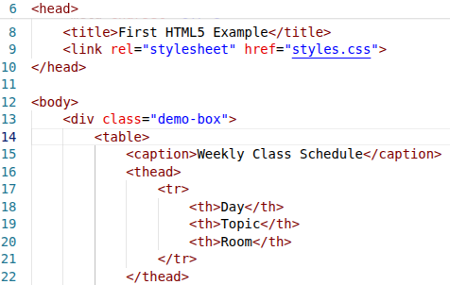
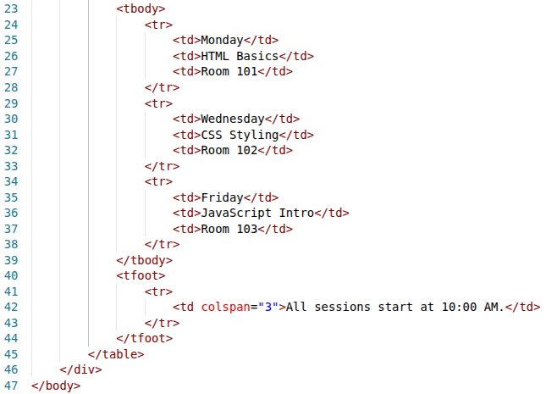
An Example of <table>

Slide 46
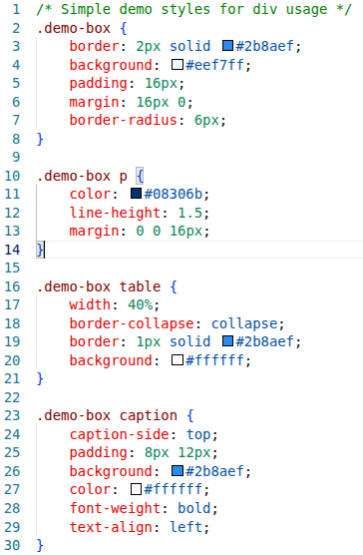
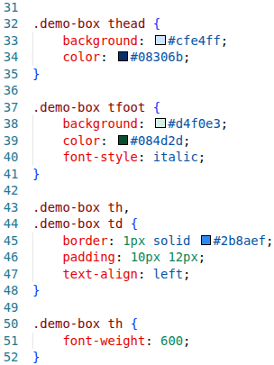
An Example of <table> ─ CSS file

Slide 47
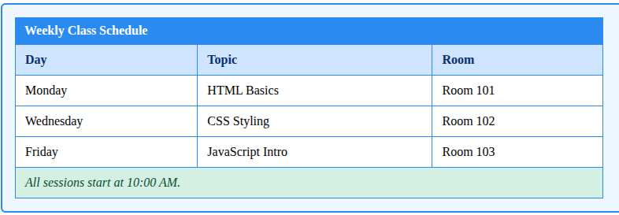
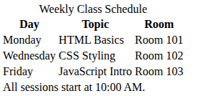
An Example of <table> ─ Content Display

Slide 48
Tabular Elements ─ <tr>, <th> and <td>
<tr>: Defines individual table rows enclosing cell elements of <tr> and <td>
<th>: Defines a header cell
<td>: Contains table data elements
When describe a table, always starts with row, i.e. <tr>, and specifies columns with <td> within <tr></tr> pair next.
rowspan and colspan attributes: The values of these attributes specify the number of rows or columns occupied by the cell.
  Can be placed inside any data cell <td> or table header cell <th>.

Slide 49
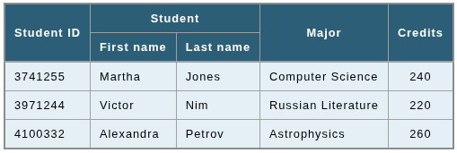
Try it Yourself ─ Tabular Design Practices
Table dimensions: *** Rows x *** Columns
Header rows: Using *** markup
Multi-row/column cells: Using *** attribute
Screenshot of html source code (table presentation only)

Slide 50
Markup Tags within <body> ─ Multimedia

Slide 51
Image Element ─ <img>
The src attribute holds the path to the image you want to embed. It is not mandatory if the srcset attribute is available. However, at least one of the src or srcset attributes must be provided.
The alt attribute holds a textual replacement for the image, which is useful for accessibility. Alt text is also displayed on the page if the image can't be loaded for some reason: network errors, content blocking, non-visual browser, image format is not supported etc.
The fetchpriority attribute provides a hint of the relative priority to use when fetching the image, values as high, low or auto.
Though width and height are optional attributes, they are helpful for rendering performance and properly display.
  If omitted, the browser uses the image’s actual width and height.
  Images are measured in pixels
Most browsers support various image format: PNG, JPEG, GIF, SVG, AVIF, APNG etc.

Slide 52
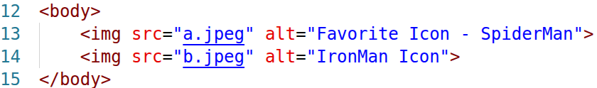
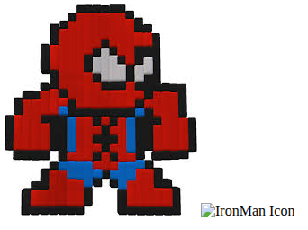

An Example of <img>
When using image as a hyperlink, following best practice of explicit link purpose.

Slide 53
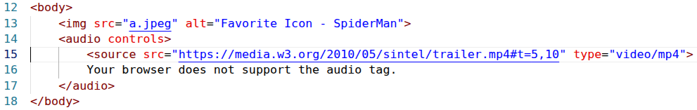
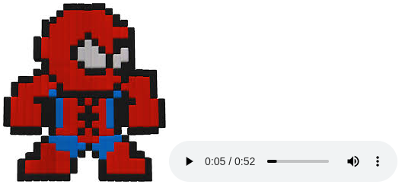
Audio Element ─ <audio>
The <audio> element is used to embed sound content in documents.
The src attribute specifies the URL of the audio to embed.
  Alternatively you can use a child element <source src=URL>.
  You can specify an interval with W3C Media Framgment URI syntax: t=start, end
Audio control attributes
  loop, muted and autoplay: A Boolean attribute.
  controls: no value is needed, just specifies the attribute name

Slide 54
Video Element ─ <video>
The <video> element embeds a media player which supports video playback into the document.
The src attribute specifies the URL of the audio to embed.
  Alternatively you can use a child element <source src=URL>.
  You can specify an interval with W3C Media Framgment URI syntax: t=start, end
Audio control attributes
  loop, muted and autoplay: A Boolean attribute.
  controls: no value is needed, just specifies the attribute name
Display area: width and height.
Better user experience with poster attribute: A URL for an image to be shown while the video is downloading.

Slide 55
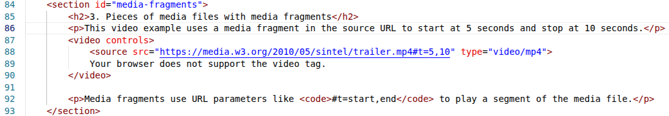
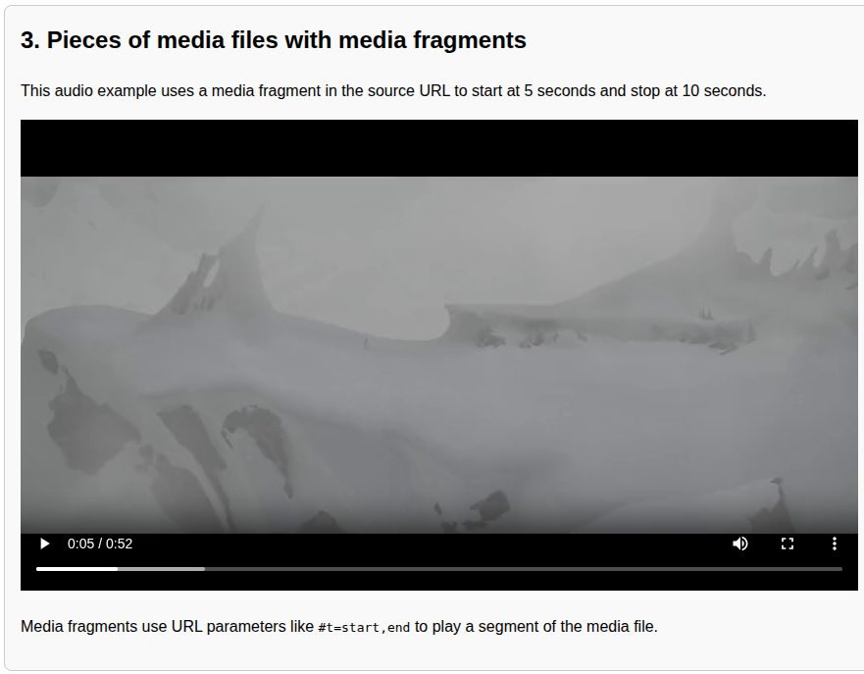
An Example of <video> ─ Media Fragment

Slide 56
Independent Embedding Element ─ <iframe>
The <iframe> element represents a nested browsing context, embedding another HTML page into the current one.
  The browsing context that embeds the others is called the parent browsing context. The topmost browsing context — the one with no parent — is usually the browser window, represented by the Window object.
The src attribute: The URL of the page to embed.
Display area: width and height.

Slide 57

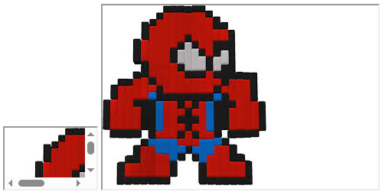
An Example of <iframe>

Slide 58


An Example of <iframe> ─ Youtube Video

Slide 59
Try it Yourself ─ Image Practices
Play around <picture> element
  Using browser’s developer tool to change device type as iPad Pro and iPhone 12 Pro (Or just resize the browser window) and check what happens.
  https://developer.mozilla.org/en-US/docs/Web/HTML/Reference/Elements/picture
Compare among <picture>, <figure> and <img> elements
  Block vs inline element
  Container vs individual replaced element
  Semantic representation ways

Slide 60
Semantic Markup Tags

Slide 61
Semantic Elements for Changes Highlight
The <del> element represents a range of text that has been deleted from a document.
  This can be used when rendering "track changes" or source code difference information.
  The cite attribute: A URI for a resource that explains the change (for example, meeting minutes).
  The datetime attribute: Indicates the time and date of the change and must be a valid date string with an optional time. A valid date string consists of a month string, followed by a hyphen character (-, or U+002D), followed by a two-digit day of the month.
The <ins> element is the oppose purpose to <del>.
The <s> element renders text with a strikethrough (same visual effect as <del> but less semantic meaning of changes, simply refers to the removal.)

Slide 62


An Example of <del>, <s> and <ins>

Slide 63
Semantic Elements for Citation or Quotation
Specific Terms
  The <abbr> element represents an abbreviation or acronym.
  The <dfn> element indicates a term to be defined.
Reference Citations
  The <cite> element is used to mark up the title of a creative work.
  The <blockquote> element indicates that the enclosed text is an extended quotation.
  The <q> HTML element indicates that the enclosed text is a short inline quotation.
Contact Information
  The <address> HTML element indicates that the enclosed HTML provides contact information for a person or people, or for an organization.

Slide 64


An Example of <dfn> and <abbr>

Slide 65


An Example of <cite>, <q> and <blockquote>

Slide 66


An Example of <address>

Slide 67

Semantic Elements for Layout ─ Try it Yourself
Source: Generated by Gemini, 2026.

Slide 68
Semantic Markup Justifications
In production-grade web development, semantic HTML is widely considered a must-have. Here is why moving away from "Div Soup" and using tags like <header>, <nav>, <main>, <article>, and <footer> (same reason for additional semantic markup of texts) is critical:
  Accessibility (The Biggest Factor): The user has to listen to everything sequentially if your website is designed with <div> soup.
  Search Engine Optimization (SEO): Search engine crawlers (like Google's bots) read your code to understand what your website is about.
  Code Maintainability and Readability: When you or your team look at a codebase months later, semantic tags act as instant documentation.

Slide 69
Further Reading
Markdown Syntax
  https://docs.apigee.com/api-platform/publish/portal/markdown-reference?hl=zh-tw

Slide 70

Questions?

